Slide 1


Improve Samples And Documentation For SDR Representation (SDR To Bitmap)
Group Name: Team_PY
Pranil Prakash Ghadi: 1441215
Yatish Sharma: 1457597

Slide 2
CONTENTS
Introduction
Encoders
Drawbitmap Method
1-d Array And 2-d Array
SDR Generation Using Various Encoders
Conclusion

Slide 3
INTRODUCTION
Our project is dedicated to refining the documentation process for converting Sparse Distributed Representations (SDR) into bitmap images. We recognize the pivotal role that clear documentation plays in fostering comprehension and utilization of SDR techniques. Our approach focuses on leveraging diverse examples and specialized encoders to enrich the clarity and accessibility of documentation. By enhancing the documentation clarity, we aim to empower users with the knowledge and tools necessary for seamless implementation of SDR techniques, thereby driving innovation and progress in data representation and analysis.

Slide 4
ENCODERS
Encoders serve as pivotal components in the conversion process of various data types into Sparse Distributed Representations (SDRs), contributing significantly to the efficacy of data representation and analysis.
Versatility : Encoders are versatile tools capable of handling a diverse range of data types, including scalar values, temporal information, geographical coordinates, and spatial patterns.
Specialization: Each encoder is meticulously crafted to cater to specific data modalities, employing specialized algorithms and methodologies tailored to the unique characteristics of the input data.
Sparsity: One of the fundamental characteristics ensured by encoders is sparsity, where only a small fraction of elements within the resulting binary vectors are active, thereby preserving relevant information while minimizing redundancy.
Configurability: Many encoders offer configurable parameters, allowing users to fine-tune properties such as resolution, sparsity, and overlap to suit the specific requirements of their data and analytical objectives.
Adaptability: Encoders possess the flexibility to accommodate diverse data modalities by utilizing specialized encoding techniques, ensuring efficient representation and analysis of complex data patterns across various domains.

Slide 5
TYPES OF ENCODERS
Scalar Encoder
Date-Time Encoder
Converts continuous scalar values into Sparse Distributed Representations (SDRs), facilitating numerical data representation in neural network models
Encodes date and time information into binary arrays, enabling temporal data representation suitable for analysis and prediction tasks.
Geo-Spatial Encoder
Spatial Pooler
Transforms geographical coordinates into binary arrays, facilitating spatial data representation and visualization in SDR format
Organizes input data into sparse distributed representations (SDRs) by selecting a subset of active columns, enhancing data representation efficiency and pattern recognition capabilities in neural networks

Slide 6
DRAWBITMAP METHOD
The DrawBitmap method plays a crucial role in visualizing Sparse Distributed Representations (SDRs) by generating bitmap images from encoded data. This method accepts parameters such as the array of active columns, output width and height, file path for saving the bitmap, colors for inactive and active cells, and optional text to be written with the bitmap
Generating Bitmaps: The primary function of the DrawBitmap method is to convert encoded SDRs into bitmap images, facilitating visual interpretation and analysis of the data.
Customization: Users can customize various aspects of the bitmap image, including the colors used for representing active and inactive cells, as well as the addition of optional text for contextual information.
Scalability: The method is designed to handle bitmap generation for varying sizes of input data, ensuring scalability and adaptability to different datasets and visualization requirements.

Slide 7
1-D ARRAYs & 2-D ARRAYs
1-D Arrays :
Linear collection of elements stored in contiguous memory.
Accessed using a single index.
Example: int[] temperatures = { 70, 72, 68, 74, 75, 71, 73 }.
Accessing specific values, such as Tuesday's temperature (72), is achieved with indices (temperatures[1]).
2-D Arrays (Matrices):
Elements organized in rows and columns.
Accessed using two indices: one for the row and one for the column.
Example:
int[,] pixels = {
{ 255, 255, 255 },
{ 0, 0, 0 },
{ 255, 255, 255 }
};
Accessing specific pixels, like row 1, column 1 (0), is done using two indices (pixels[1, 1]).

Slide 8
1-D ARRAYs & 2-D ARRAYs
Encoding Process:
The Encode() method processes inputs, generating 1-D arrays, often Sparse Distributed Representations (SDRs).
These SDRs can be converted into 2-D arrays, possibly for visualization or further processing.
Example: int[,] twoDimenArray2 = ArrayUtils.Make2DArray<int>(result2, (int)Math.Sqrt(result2.Length), (int)Math.Sqrt(result2.Length)).

Slide 9
SDR Generation Using Scalar Encoder
Scalar Encoder
Scalar encoding is a pivotal technique employed to convert continuous scalar values into Sparse Distributed Representations (SDRs), widely utilized in neural network models. By discretizing the input range into smaller bins and selectively activating specific bits within each bin, scalar encoding generates binary vectors representing numerical values while preserving semantic information in a high-dimensional space.
DrawBitmap Sample for Scalar Encoder:
Initially, scalar encoders are configured with predefined settings via their constructors, including parameters such as width (W), total number of bits (N), minimum value (MinVal), and maximum value (MaxVal). Once initialized, the Encode() method is invoked with input values to commence the encoding process, yielding binary arrays that signify the encoded values. Subsequently, to visualize the encoded data, the printBitMap function is utilized within the Test Method, exemplified by TestMethod9 in a unit test scenario. This method encodes input data, yielding a 1-D array (result1), subsequently transformed into a 2-D array. The resulting 2-D array is transposed and passed to the DrawBitmap method, where each SDR is represented as a bitmap image. Notably, active bits are depicted in dark orange, while inactive bits are represented in yellow, facilitating visual interpretation of the generated SDRs.

Slide 10
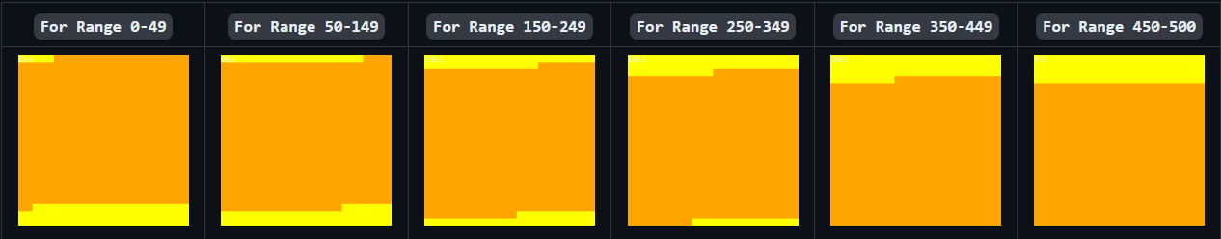
SDR Generation Using Scalar Encoder
Example
In this example, the value of N is set 20 while initializing the encoding parameters for the encoder. So, the size of SDR which is saved in result1 is 20.
As this value is then converted to 2-D Array, hence 20 is passed to the (int) Math.Sqrt(result1.Length) and (int) Math.Sqrt(result1.Length) This becomes (int) Math.Sqrt(20) = 4 and (int) Math.Sqrt(20) = 4
These results are then transposed and passed to the DrawBitmap method. In this method In this method
Height and Width of the Bit Map is set to 1024.
The Path to the output folder is also mentioned. The generated Bit Maps will be saved in this folder.
An active bit in the SDR is represented by Dark Orange color and an inactive bit is represented by Yellow color.
We also see the value of i for which the Bit Map is generated in the top left corner of the Bit Map.

Slide 11
SDR Generation Using DateTime Encoder
DateTime Encoder
The DateTime Encoder serves as a crucial component for converting date and time information into Sparse Distributed Representations (SDRs). Initialized with specific settings such as width (W), number of bits (N), minimum and maximum values, periodicity, and padding, this encoder's Encode() method processes input date and time data, resulting in the generation of a one-dimensional array (1-D array) representing the Sparse Distributed Representation.

Slide 12
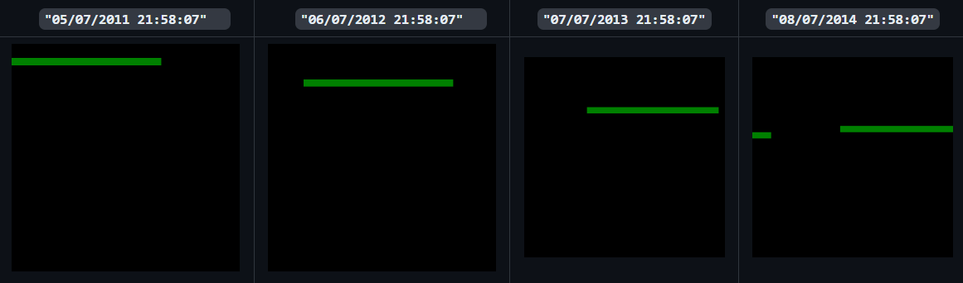
SDR Generation Using DateTime Encoder
DrawBitmap Sample for DateTime Encoder:
To visualize the generated SDRs, the bitmap representation is employed, facilitating the conversion of SDRs into a two-dimensional array (twoDimArray). The resultant SDRs can then be further visualized using tools like DrawBitmap(), which generates bitmap images from the SDRs. In a practical example, the 1-D array (result2) is converted into a 2-D array (twoDimenArray2), followed by the transposition of the 2-D array. This transposed array is then passed to the DrawBitmap method, where width and height are set to 1024 pixels. Additionally, inactive cells are represented in black, while active cells are depicted in green, providing a clear visual representation of the encoded date and time information.

Slide 13

SDR Generation Using Geo-Spatial Encoder
Geo-Spatial Encoder
The Geospatial Encoder is instrumental in converting geospatial data into binary arrays, enabling the visualization of geographical information as bitmap images. Through Sparse Distributed Representations (SDRs), encoded geographical coordinates are translated into visually interpretable bitmap images, allowing for insightful analysis of spatial information encoded within SDRs.

Slide 14
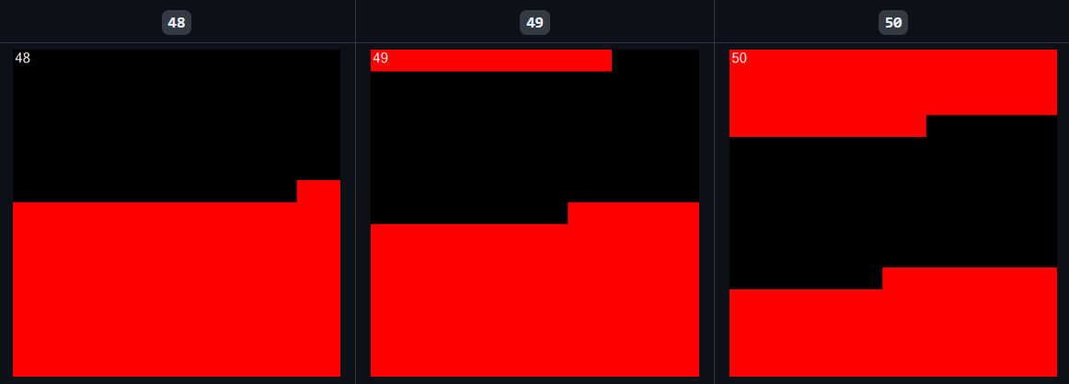
SDR Generation Using Geo-Spatial Encoder
DrawBitmap Sample for Geo-Spatial Encoder:
In order to generate SDRs and bitmap images, specific parameters such as width (W), number of bits (N), minimum value (MinVal), and maximum value (MaxVal) are set to define the encoding of geospatial data into binary arrays. Using the DrawBitmap method, the encoded data is visualized as bitmap images. For example, by iterating through a loop of geospatial values within the specified range, corresponding SDRs are generated and converted into a two-dimensional array (twoDimenArray). This array is then transposed and passed to the DrawBitmap method, where the bitmap's height and width are set to 1024 pixels. Active and inactive cells are represented in black and red colors, respectively, providing clear visualizations of the encoded geospatial data.

Slide 15
CHANGES IN THE SIZE AND COLOR OF BITMAP
Modification of Encoder Parameters:
Adjusting parameters such as width (W), total number of bits (N), minimum value (MinVal), and maximum value (MaxVal) of the encoder can significantly impact the resulting Sparse Distributed Representations (SDRs) and their bitmap representations.
For instance, modifying parameters to W = 21, N = 40, MinVal = 48.75, and MaxVal = 51.86 alters the size and characteristics of the generated SDRs.
Changes in Bitmap Representation:
The resulting 1-D array size becomes 40, subsequently converted into a 2-D array with dimensions 6x6.
Setting both the height and width of the bitmap to 1024 pixels. Now each cell corresponds to 170 pixels in the bitmap.
Notably, the color scheme of the bitmap is modified, using red for inactive cells and green for active cells, providing clearer visual cues for interpretation.

Slide 16



CHANGES IN THE SIZE AND COLOR OF BITMAP
Example SDR Generation:
For instance, when encoding input 51.85, the resulting SDR is represented by a 1-D array with values indicating the activation status of each cell. In this example, the SDR exhibits a transition from inactive (0s) to active (1s) cells, indicative of the input value's representation within the SDR framework.
Now by changing the parameters you can see the difference between the output of Geospatial Encoder output bitmaps and the bitmaps given below.

Slide 17
SDR Generation Using Spatial Pooler
Spatial Pooler
Utilizing Hierarchical Temporal Memory (HTM) principles, a Spatial Pooler (SP) is trained with input images to generate Sparse Distributed Representations (SDRs) for each image. The SP identifies patterns in the input images and produces corresponding SDRs that encapsulate these patterns. These SDRs are then translated into bitmap representations to visualize the activation patterns of the SP columns.

Slide 18
SDR Generation Using Spatial Pooler
Process Overview:
Initialization and Training: The SP is initialized with configurable parameters such as potential radius, percentage, global inhibition, and local area density. Training images are loaded from a specified directory, and each image's input vector is computed using image binarization techniques.
Computing SDRs: The input vectors are fed into the SP using the compute() method, which calculates active columns based on the input. These active columns are determined by finding indices where the value is equal to 1 in the output array of the SP.
SDR Visualization: Once the system converges to a stable state, the active columns obtained from the SP represent the SDR for the input image. These SDRs are stored in a dictionary with the image file name as the key. The activeArray computed by the spatial pooler is converted into a 2-dimensional array, which is then used as input for bitmap generation.
Bitmap Generation: The DrawBitmaps function from NeoCortexUtils is employed to construct bitmap representations of the SDRs. This function takes parameters such as arrays, output image file, colors for active and inactive cells, and image dimensions to generate visually interpretable bitmap images showcasing the activation patterns of the SP columns.

Slide 19
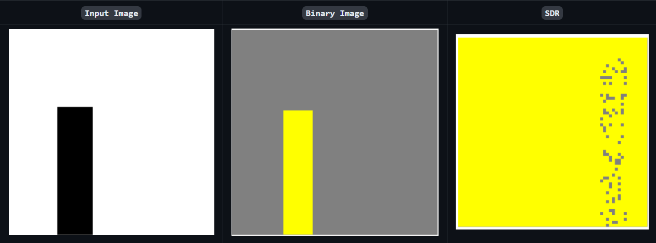
SDR Generation Using Spatial Pooler

Slide 20
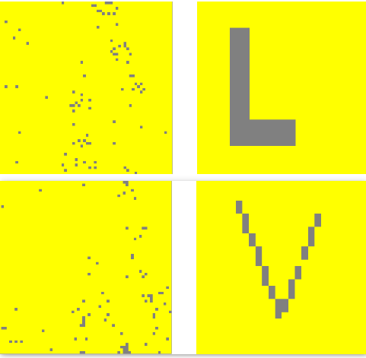
Example Representing Overlap(Intersection),Difference and Union for Alphabet L and V in Bitmap after computing in spatial pooler
General Bitmap representation of L and V

Slide 21
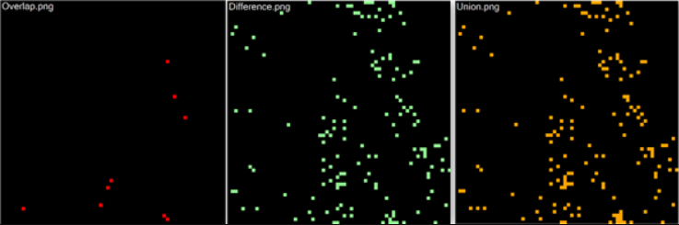
Example representing Overlap(Intersection),Difference and Union for Alphabet L and V in Bitmap after computing in spatial pooler
These are thebitmap represenatation for Overlap, Difference and Union of SDR of L and V

Slide 22
CONCLUSION
Exploration of bitmap representation using encoders and the Spatial Pooler highlights the efficacy of SDRs in capturing intricate data patterns.
Encoders like Scalar, DateTime, and Geospatial efficiently convert diverse data types into binary arrays for processing by the Spatial Pooler.
Visualizing SDRs as bitmaps offers valuable insights into SP column activation patterns, aiding in pattern recognition and analysis tasks.
Clear documentation and visualization techniques are crucial for understanding and utilizing SDR representations effectively.
Continued innovation in encoding, optimization, and visualization methods promises further advancements in bitmap representation techniques and their applications across various domains.

Slide 23

THANK YOU

